Slide 1




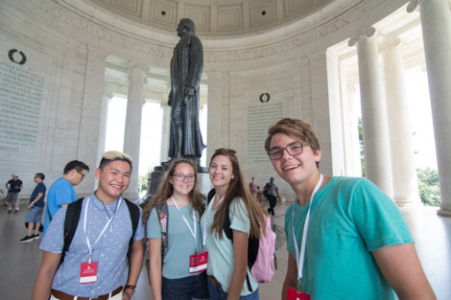



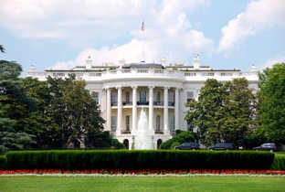




Sauganash Elementary School’s Washington D.C. Trip Meeting

Slide 2

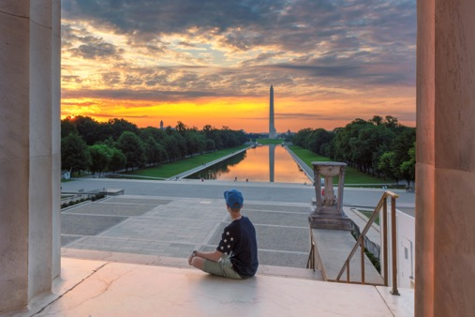
In This Meeting…
01
Our Trip and all that we’re going to see and do
02
What’s Included in our travel program
03
Our Travel Partner WorldStrides and why we are so excited to work with them
04
How to Sign Up for this incredible opportunity

Slide 3


A Trip You’ll Remember for Years to Come
Your source for info about the additional Covid-19 related health & safety measures that will be in place for your trip.

Slide 4
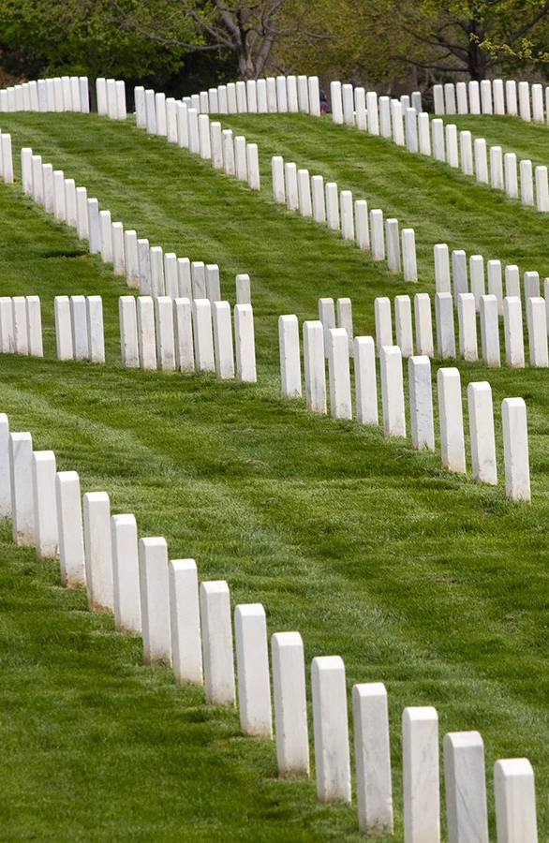
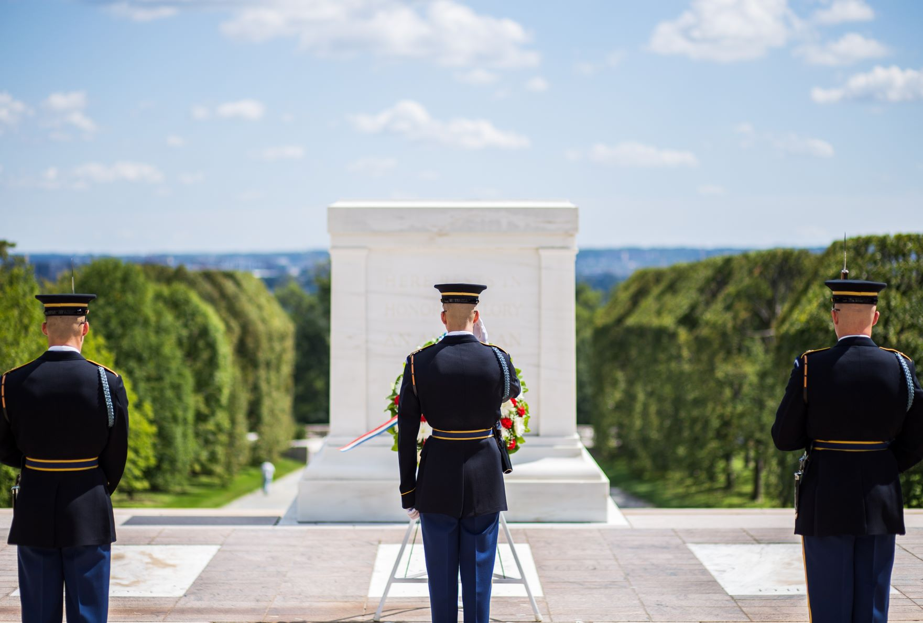
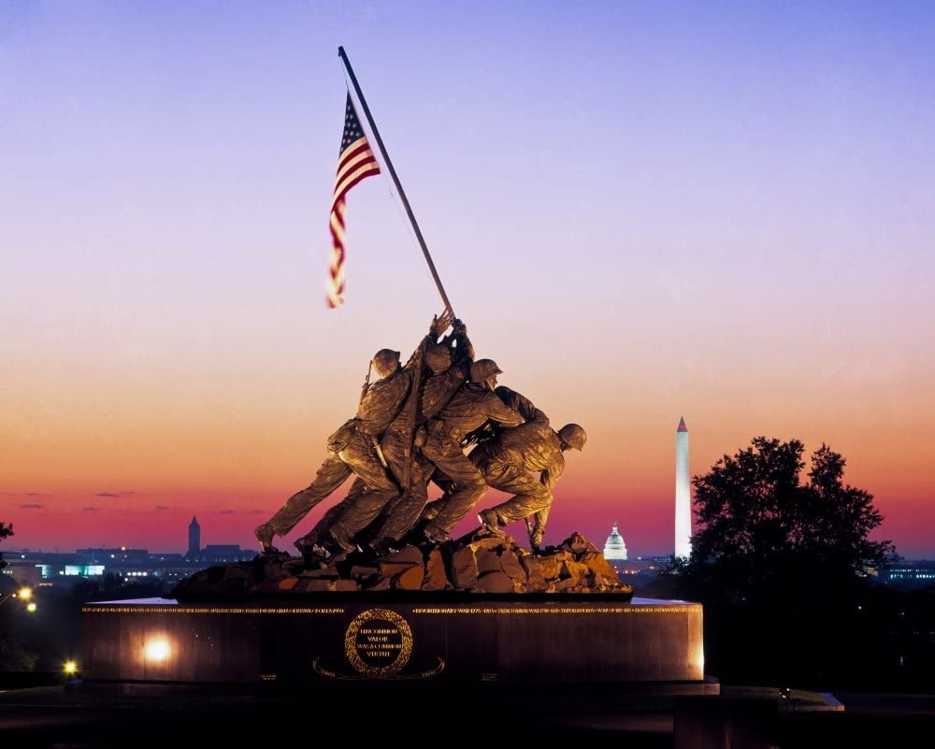
Tomb of the Unknown Soldier
Marine Corps Memorial
Arlington National Cemetery

Slide 5
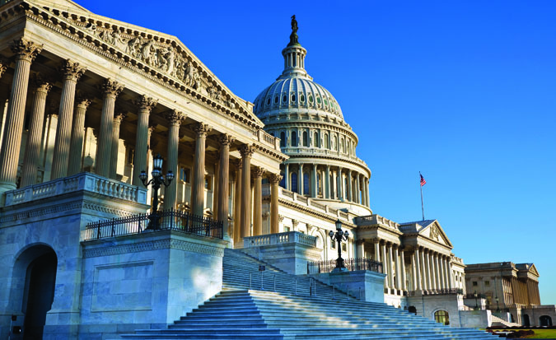


United States Capitol. Supreme Court. Library of Congress.

Slide 6
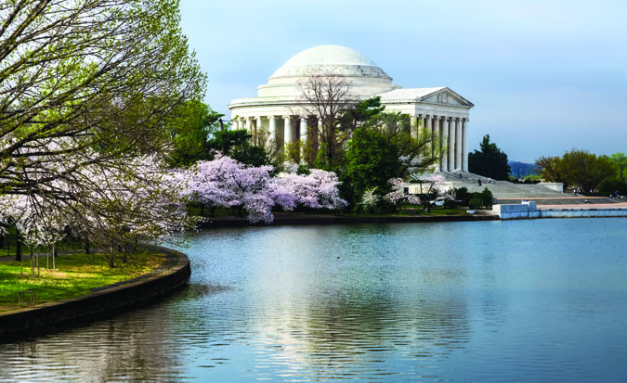
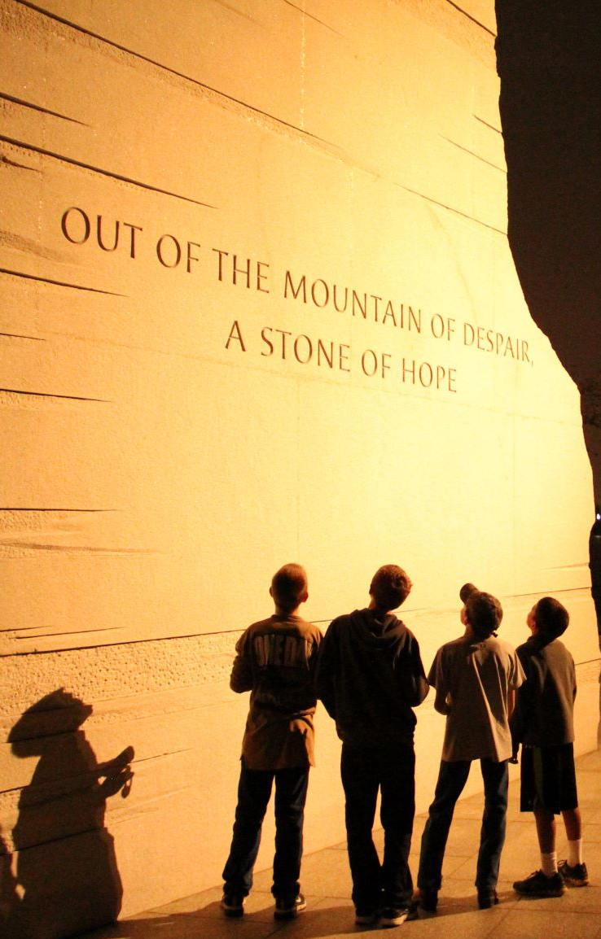
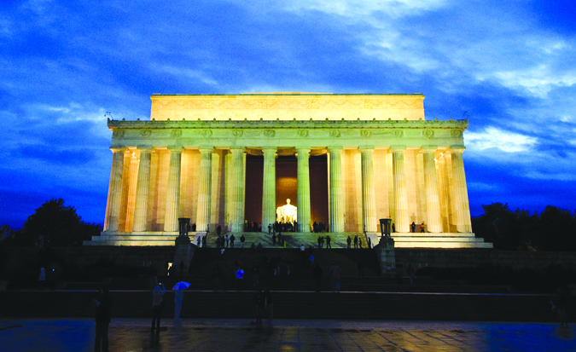
Jefferson Memorial
Martin Luther King Jr Memorial
Lincoln Memorial

Slide 7
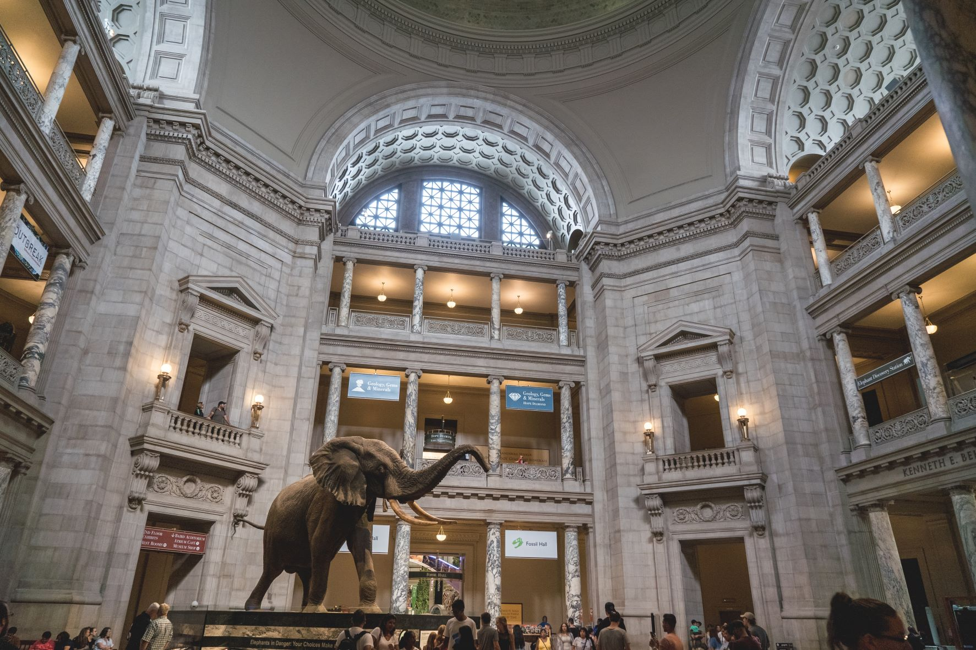
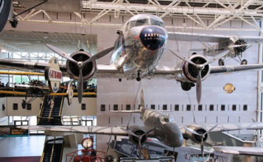
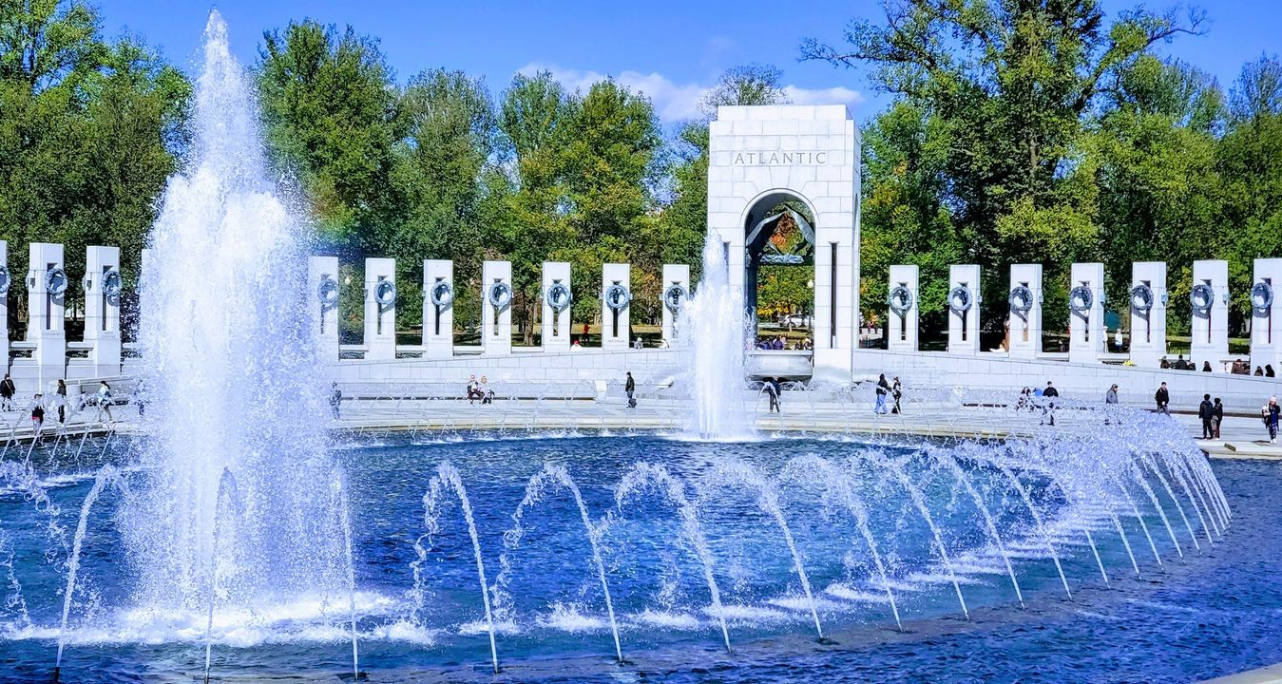
World War II Memorial
Smithsonian Museums

Slide 8
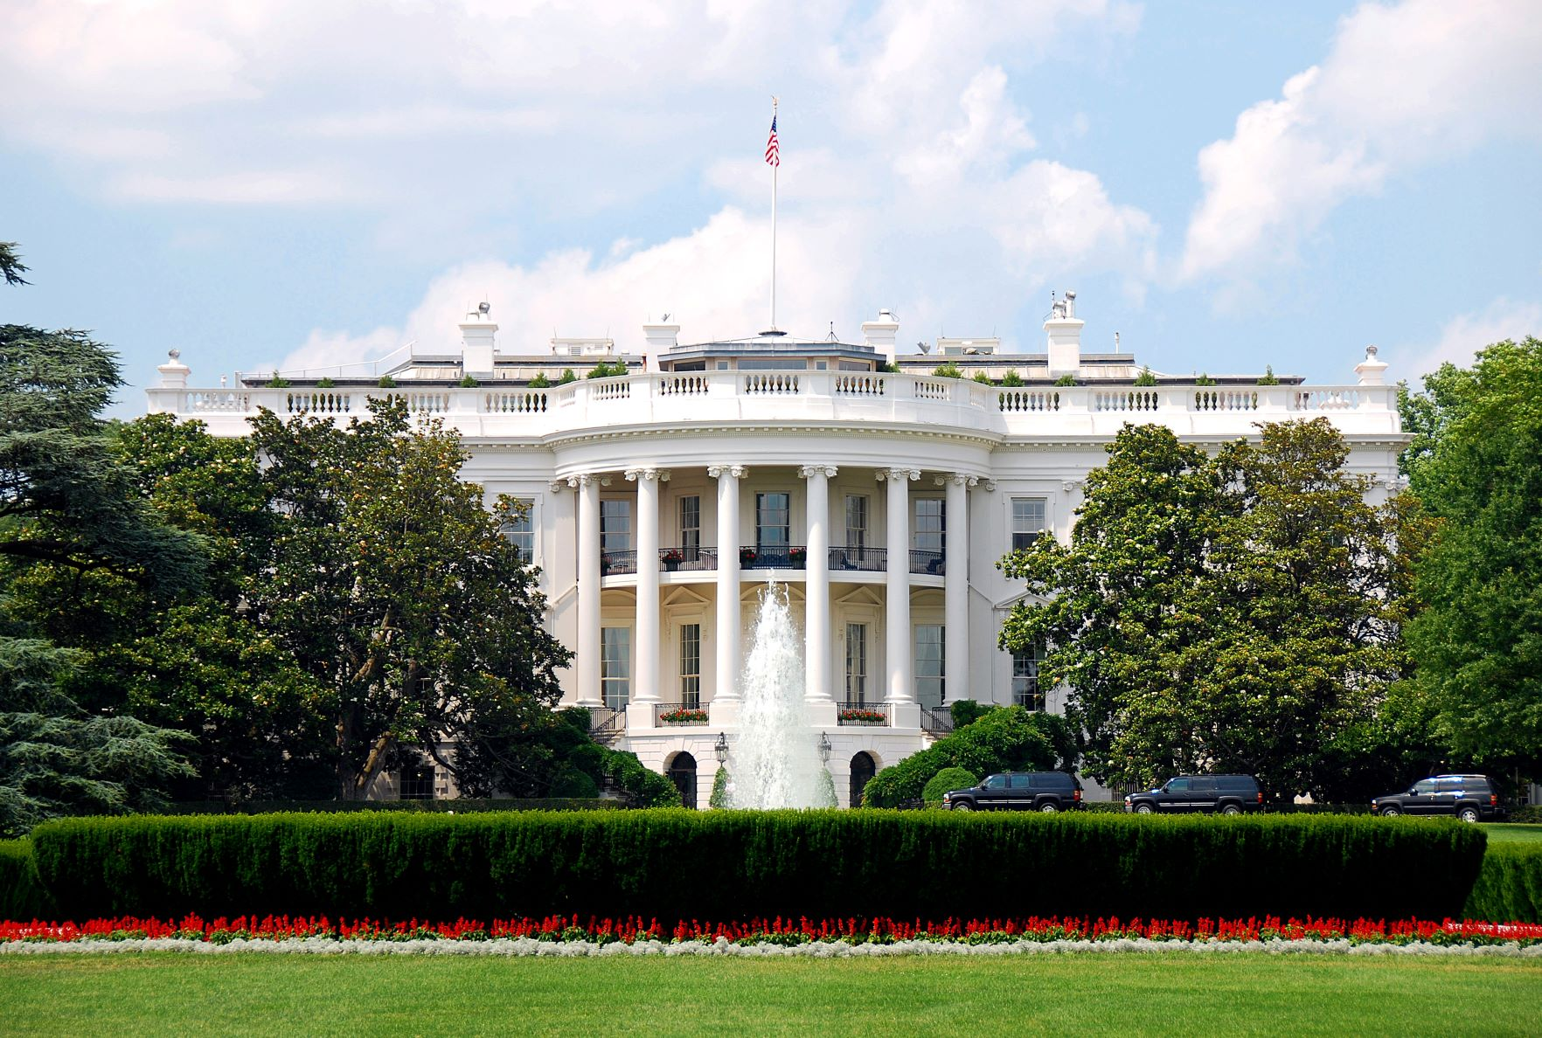
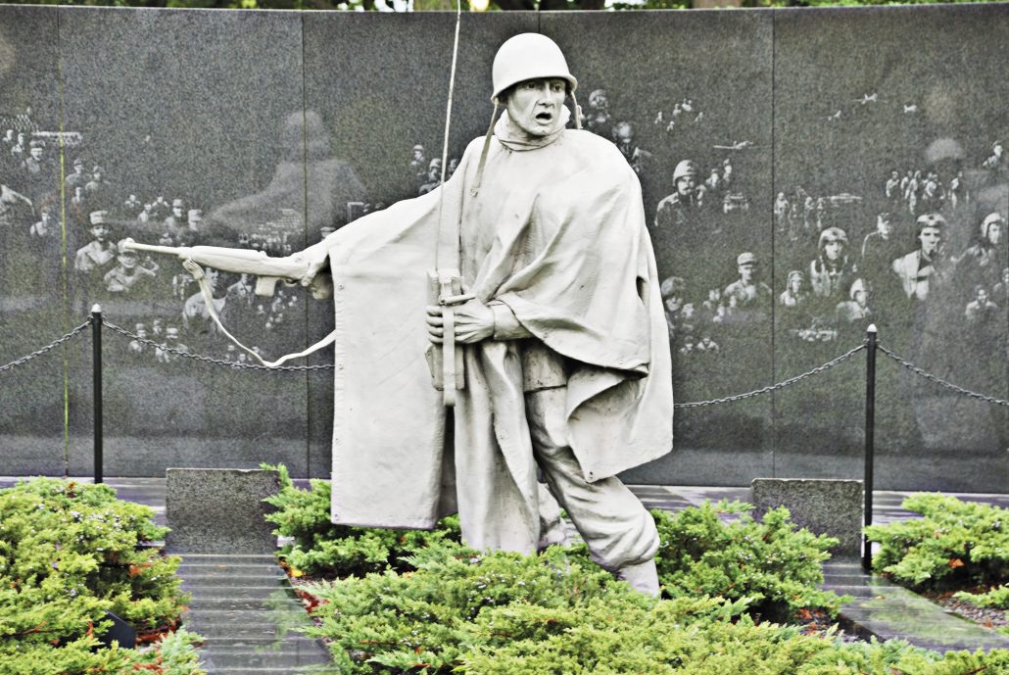
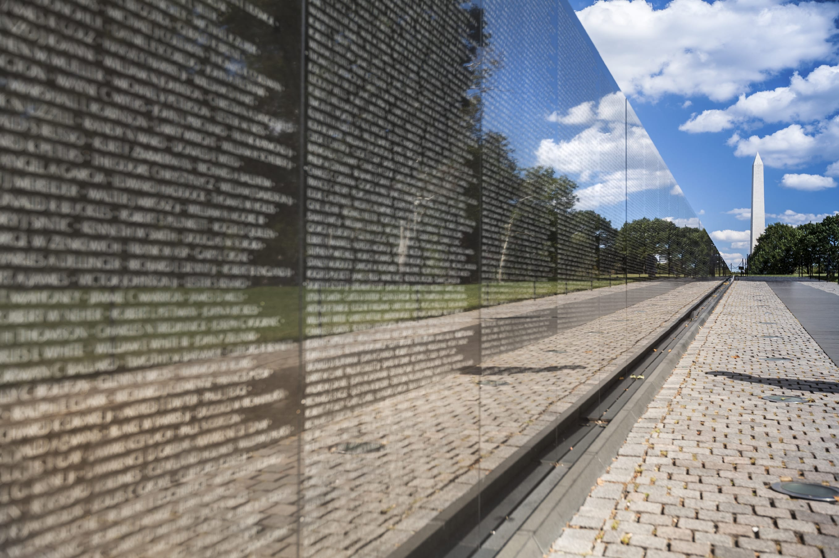
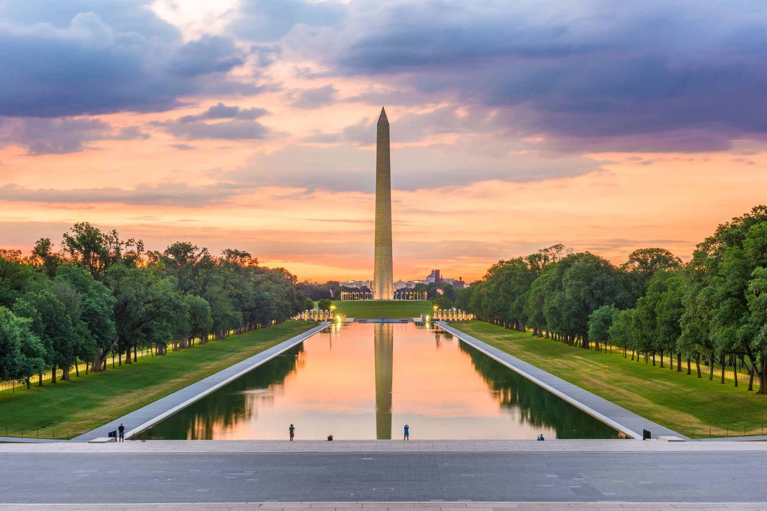
White House
Korean War Memorial
Vietnam Veterans Memorial
Washington Monument

Slide 9





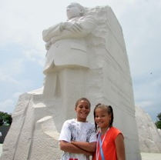

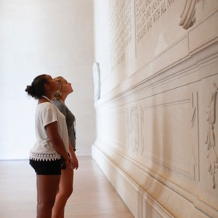



Our Trip Includes
Hotel Accommodations
Transportation to & from our destination, and throughout the trip
Meals
Attractions & Activities
Course Leader
Discovery Journals
Safety and Support
Notes:
So let’s talk about the specific details of our trip.
<<PL mentions the trip information letter that they have already shared with the families. They’ll review the highlights of the trip and mention a few of the sights that they’re looking forward to the most. They’ll end by saying how they’ll continue to work with WorldStrides over the coming months to finalize the exact itinerary – one that maximizes fun with learning. If PL has photos from prior trips and wants to show, they can, otherwise that travel photo slide can be deleted>>

Slide 10
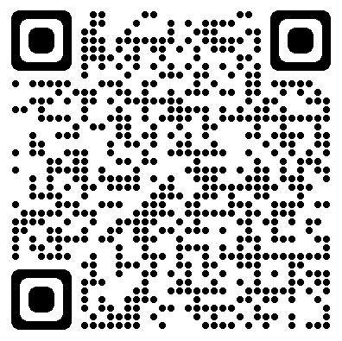
Our Trip Details
Trip Dates: October 11 – 13, 2024
Price: $1,730
Deposit: $49required to secure your spot!
Our Registration Deadline is: October 26th, 2023
Trip ID: 212926
Full Refund Protection Plan: $235
Provides a full refund of all monies paid to WorldStrides (minus the cost of the FRP program and any other non-refundable fees) should you have to cancel for any reason.
Sign up by 10/26/23 and receive a discount of $100 off the trip price!

Slide 11




Slide 12


FLAG Financial Assistance
More than $2.5 million in financial assistance given out each year
Families with an annual adjusted gross income of $85,000 or less may qualify
Learn how much may be available to you by calling 800-468-5899

Slide 13

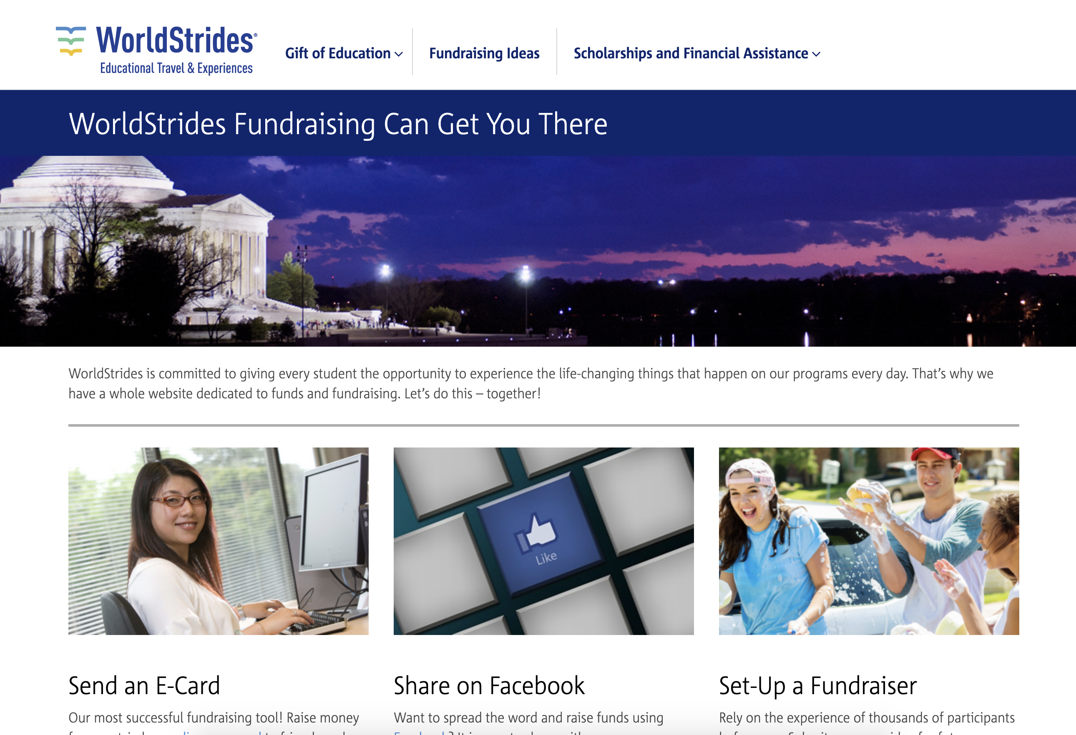


The Gift of Education
Students can send e-cards, share links on social media, or send letters to friends and family
100% of the money raised goes to offset the trip price
Get started at
worldstridesfundraising.com

Slide 14
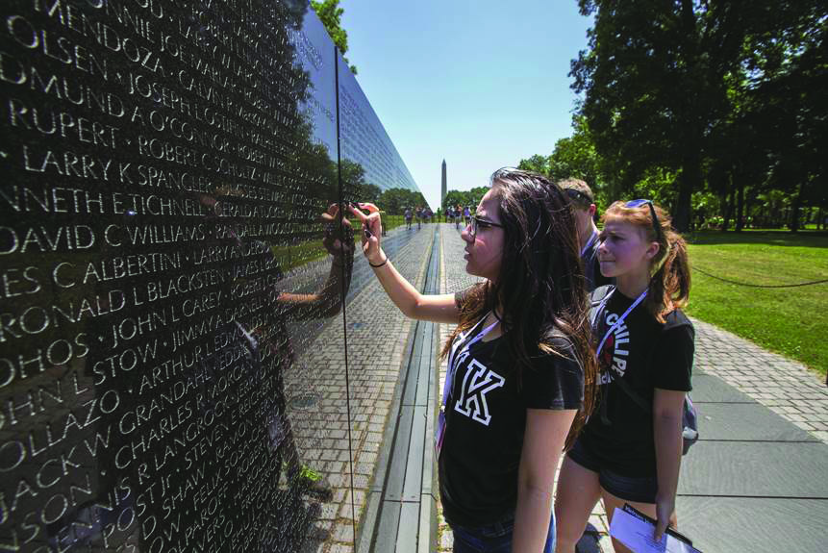

Affordable Payment Plans
Only a small initial deposit required to sign up for the trip
Remaining balance spread out into small installments and paid monthly prior to travel
Payments can be auto-deducted from your account

Slide 15
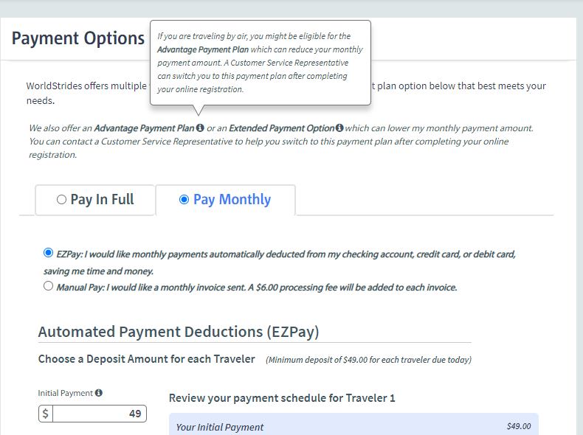

Selecting a Payment Plan When Signing Up
Extended plans also available
Select Pay Monthly option
You will see the initial deposit and then your monthly payment amounts
On next screen, enter your banking information for payments to be auto-drafted each month.
Sign up at worldstrides.com/register or by calling 800-468-5899

Slide 16




Thank You for Attending!
Sign up TONIGHT! Our Trip ID is 212926
Online: worldstrides.com/register
Phone: 800-468-5899
Questions? Email contact@sauganashtodc.com
We can’t wait to see you all in Washington, D.C.!

